Slide 1
Deadlock

Slide 2
Introduction
Generally, resources in a computer system can be partitioned into several types:
Memory
CPU Cycle
Files
I/O Devices
Printer
DVD Drivers
Etc…

Slide 3
Introduction
A process must requests for resources before using them and it has to release the resources after using them.
A process may request as many resources as it required to carry out its designated task.
But may not exceed the total number of resources available in the system.
Request
Use
Release

Slide 4
Introduction
A process often requests for resources (printer, harddisk, etc); if the resources are not available at that time, the process enters the waiting state.
Sometimes, a waiting process is never able to change state, because the resources it has requested are held by another waiting process.

Slide 5


Introduction
A attempts to print a file and write the file to a DVD.
B attempts to print a file in a DVD.
Waiting for DVD Drive
Waiting for Printer
Process A
Process B

Slide 6
Introduction
This situation is called deadlock.
A set of processes is in a deadlocked state when every process in the set is waiting for an event that can be caused only by another process in the set.

Slide 7
Introduction
In a deadlock situation, processes never finish executing, and system resources are tied up, preventing other processes from starting.
Resulted in deterioration of the system’s performance, because resources are being held by processes that cannot run.
As more and more processes make requests for resources, they will eventually enter a deadlocked state.
The system will stop functioning and will need to be restarted manually.

Slide 8
Objectives
Concept of deadlock.
Describe methods that can be used to prevent or deal with deadlocks.

Slide 9
Managing Resources
Operating system also serves as the resource allocator.
Ensure resources requested by a process will be allocated to the process eventually.
A system table is used to record whether each resource is free or has been allocated to a process, as well as which process that the resource has been allocated.
If a process requests for a resource that is currently allocated to another process, it can be added to a queue of processes waiting for this resource.

Slide 10
Deadlock
It can arise only if the following four conditions hold simultaneously in a system.
Mutual Exclusion
Hold and Wait
No preemption
Circular Wait

Slide 11
Four Conditions
Mutual Exclusion
Only one process is allowed to use the resource at a time.
If another process (e.g. A) requests for the same resource, then the requesting process (A) must be delayed.
Hold and Wait
A process is holding at least one resource and waiting to acquire additional resources that are currently being held by other processes.

Slide 12
Four Conditions
No Preemption
Resources cannot be preempted.
A resource can be released only voluntarily by the process that is currently holding it.
Circular Wait
A set {P₀, P₁, …, P_{n}} of waiting processes form a circular chain:
R₀
R₁
R_{n}
P₀
P₁
P_{n}

Slide 13
Resource-Allocation Graph
Consists of:
A set of vertices V partitioned into two types of nodes:
All the active processes, e.g. P = {P₁, P₂, …, P_{n}}
All resources in the system, e.g. R = {R₁, R₂, …, R_{n}}
A set of edges E
A directed edge from process P_{i} to resource type R_{j}: P_{i} → R_{j}
This signifies that process P_{i} has requested an instance of resource type R_{j} and is currently waiting for that resource.

Slide 14
Resource-Allocation Graph
P = {P₁, P₂, P₃}, R = {R₁, 2 x R₂, R₃, 3 x R₄}
One instance of resource type R₁. (e.g. Printer)
Two instances of resource type R₂. (e.g. Harddisk)
One instance of resource type R₃. (e.g. CPU)
Three instances of resource type R₄. (e.g. DVD Drives)
E = {P₁→R₁, P₂→R₃ , R₁→P₂ , R₂→P₂ , R₂→P₁ , R₃→P₃}
R₁
R₃
P₁
P₂
P₃
R₂
R₄

Slide 15
Resource-Allocation Graph
With Deadlock:
R₁
R₃
Waiting…
P₁
P₂
P₃
Waiting…
Waiting…
R₂
R₄
P₁ → R₁ → P₂ → R₃ → P₃ → R₂ → P₁

Slide 16
Resource-Allocation Graph
In summary, if a resource-allocation graph does not have a cycle, then the system is not in a deadlocked state.
If there is a cycle, then the system may or may not be in the deadlocked state.
Processing…
Done
P₂
R₁
Processing…
Waiting…
Processing…
Waiting…
P₁
P₃
Processing…
P₁ → R₁ → P₃ → R₂ → P₁
Circular, But No Deadlock
Done
P₄
R₂

Slide 17
Basic Facts: Deadlock
If graph contains no cycles ⇒ no deadlock.
If graph contains a cycle ⇒
if only one instance per resource type, then deadlock.
if several instances per resource type, possibility of deadlock.

Slide 18
Strategy For Deadlock
HOW TO HANDLE DEADLOCKS – GENERAL STRATEGIES
There are three methods:
Ignore the problem and pretend that deadlocks never occur in the system
Ensure deadlock never occurs using either
Prevention: Prevent any one of the 4 conditions from happening.
Avoidance: Allow all deadlock conditions, but calculate cycles about to happen and stop dangerous operations..
Allow deadlock to happen. This requires using both:
Detection: Know a deadlock has occurred.
Recovery: Regain the resources.
Ignore the problem and pretend that deadlocks never occur in the system

Slide 19
Deadlock Prevention
Do not allow one of the four conditions to occur.
Mutual exclusion:
a) Automatically holds for printers and other non-sharables.
b) Shared entities (read only files) don't need mutual exclusion (and aren’t susceptible to deadlock.)
c) Prevention not possible, since some devices are intrinsically non-sharable.
Hold and wait:
a) Collect all resources before execution.
b) A particular resource can only be requested when no others are being held. A sequence of resources is always collected beginning with the same one.
c) Utilization is low, starvation possible.

Slide 20
Deadlock Prevention (Cont.)
No preemption:
a) Release any resource already being held if the process can't get an additional resource.
b) Allow preemption - if a needed resource is held by another process, which is also waiting on some resource, steal it. Otherwise wait.
Circular wait:
a) Number resources and only request in ascending order.
b) EACH of these prevention techniques may cause a decrease in utilization and/or resources. For this reason, prevention isn't necessarily the best technique.
c) Prevention is generally the easiest to implement.

Slide 21
Deadlock Avoidance
If we have prior knowledge of how resources will be requested, it's possible to determine if we are entering an "unsafe" state.
Possible states are:
Deadlock No forward progress can be made.
Unsafe state A state that may allow deadlock.
Safe state A state is safe if a sequence of processes exist such that there are enough resources for the first to finish, and as each finishes and releases its resources there are enough for the next to finish.
The rule is simple: If a request allocation would cause an unsafe state, do not honor that request.
NOTE:
A safe state is not a deadlocked state. Conversely, a deadlocked state is an unsafe state. Not all unsafe states are deadlocks.
An unsafe state may lead to a deadlock.

Slide 22
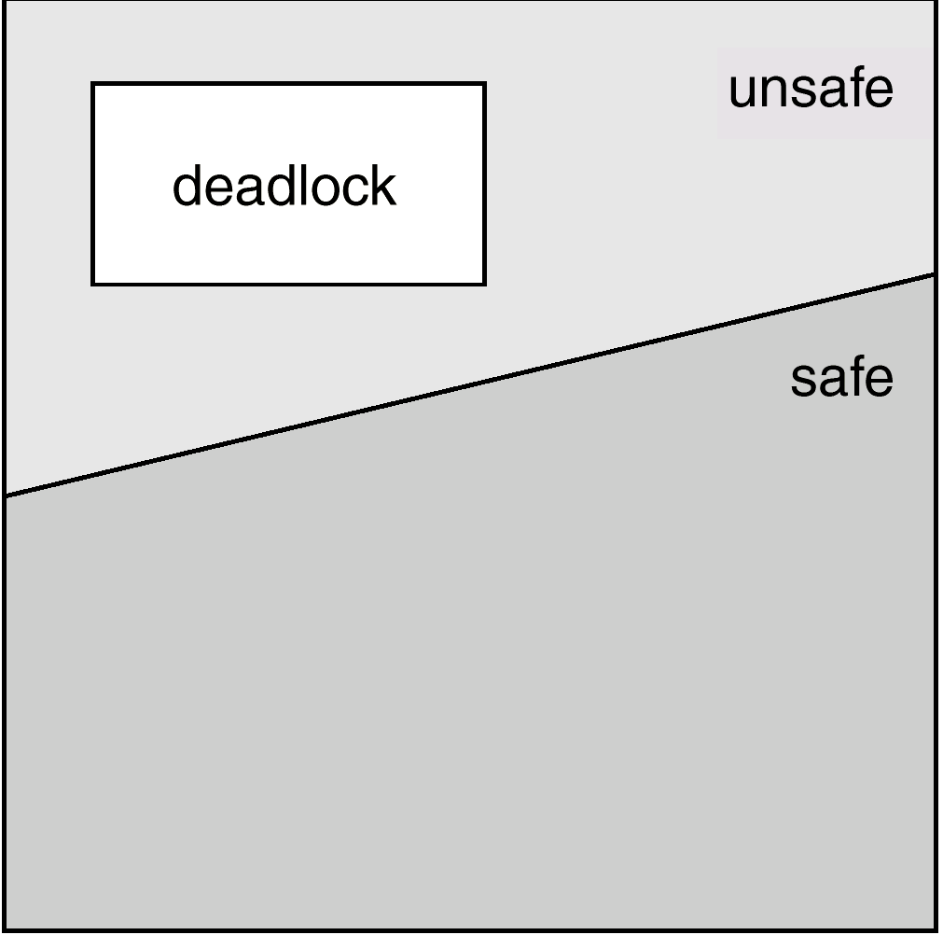
Safe, unsafe , deadlock state spaces

Slide 23
Basic Facts: Deadlock Avoidance
If a system is in safe state ⇒ no deadlocks.
If a system is in unsafe state ⇒ possibility of deadlock.
Avoidance ⇒ ensure that a system will never enter an unsafe state.

Slide 24
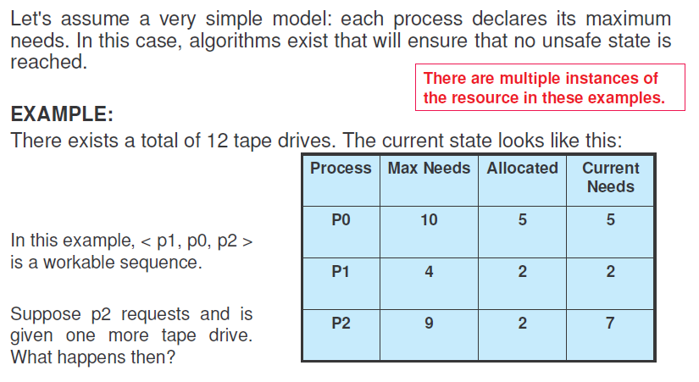
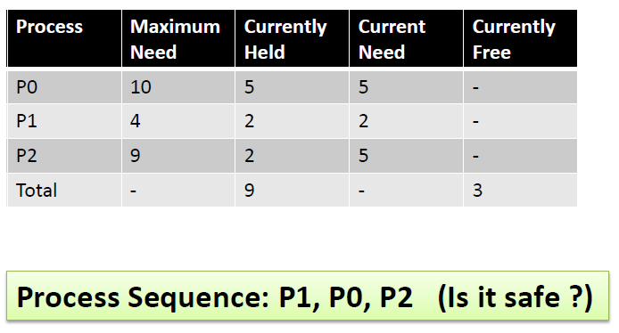
Example: Deadlock Avoidance

Slide 25
Banker’s Algorithm
Always keep so many resources that satisfy the needs of at least one process.
Multiple instances.
A new process must declare the maximum number of instances of each resource type that it may need.
This number may not exceed the total number of resources in the system
System grants request only if the request will result into a safe state.

Slide 26
Data Structures for the Banker’s Algorithm
Let n = number of processes, and m = number of resources types.
Available: Vector of length m. If available [j] = k, there are k instances of resource type R_{j} available.
Max: n x m matrix. If Max [i,j] = k, then process P_{i} may request at most k instances of resource type R_{j}.
Allocation: n x m matrix. If Allocation[i,j] = k then P_{i} is currently allocated k instances of R_{j.}
Need: n x m matrix. If Need[i,j] = k, then P_{i} may need k more instances of R_{j} to complete its task.
Need [i,j] = Max[i,j] – Allocation [i,j].

Slide 27
Resource-Request Algorithm for Process P_{i}
Request_{i} = request vector for process P_{i}. If Request_{i} [j] = k then process P_{i} wants k instances of resource type R_{j.}
1. If Request_{i} ≤ Need_{i} go to step 2. Otherwise, raise error condition, since process has exceeded its maximum claim.
2. If Request_{i} ≤ Available, go to step 3. Otherwise P_{i} must wait, since resources are not available.
3. Pretend to allocate requested resources to P_{i} by modifying the state as follows:
Available := Available - Request_{i};
Allocation_{i} := Allocation_{i} + Request_{i};
Need_{i} := Need_{i} – Request_{i;;}
If safe ⇒ the resources are allocated to P_{i}.
If unsafe ⇒ P_{i} must wait, and the old resource-allocation state is restored

Slide 28
Deadlock Avoidance
Safety Algorithm
A method used to determine if a particular state is safe. It's safe if there exists a sequence of processes such that for all the processes, there’s a way to avoid deadlock:
The algorithm uses these variables:
Need[I] – the remaining resource needs of each process.
Work - Temporary variable – how many of the resource are currently available.
Finish[I] – flag for each process showing we’ve analyzed that process or not.
need <= available + allocated[0] + .. + allocated[I-1] <- Sign of success
Let work and finish be vectors of length m and n respectively.

Slide 29
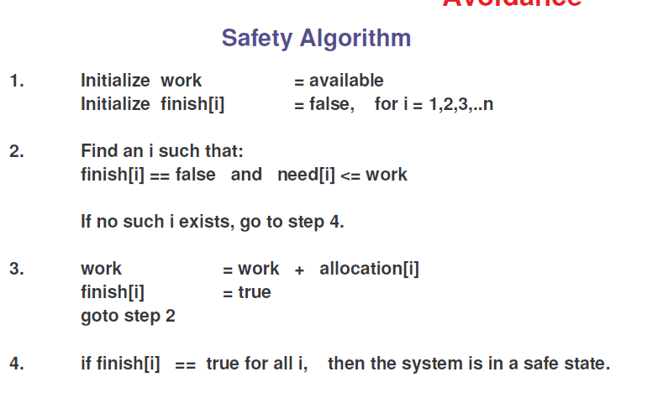
Deadlock Avoidance

Slide 30
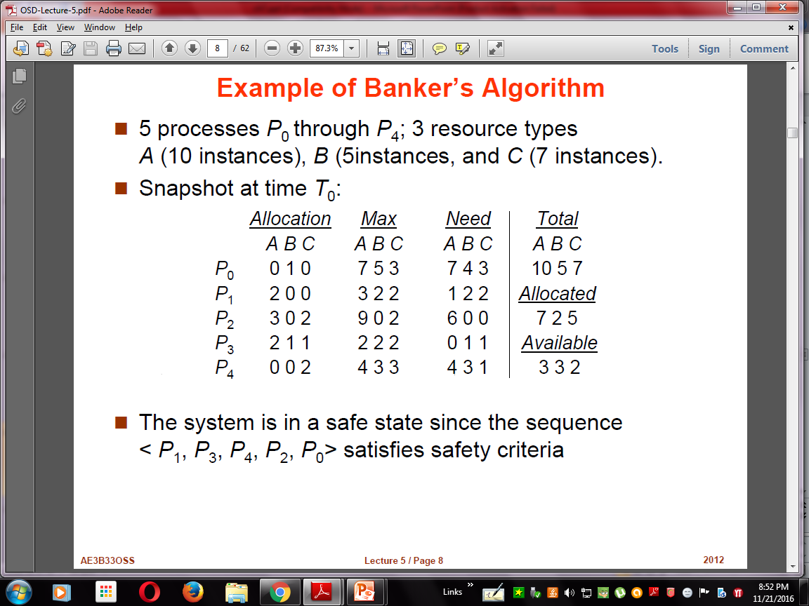
Example of Banker’s Algorithm
5 processes P₀ through P₄; 3 resource types A (10 instances), B (5instances), and C (7 instances).
Snapshot at time T₀:
Allocation Max Available
A B C A B C A B C
P₀ 0 1 0 7 5 3 3 3 2
P₁ 2 0 0 3 2 2
P₂ 3 0 2 9 0 2
P₃ 2 1 1 2 2 2
P₄ 0 0 2 4 3 3

Slide 31
Example (Cont.)
The content of the matrix. Need is defined to be Max – Allocation.
Need
A B C
P₀ 7 4 3
P₁ 1 2 2
P₂ 6 0 0
P₃ 0 1 1
P₄ 4 3 1
The system is in a safe state since the sequence < P₁, P₃, P₄, P₂, P₀> satisfies safety criteria.

Slide 32
Example (Cont.): P₁ request (1,0,2)
Check that Request ≤ Available (that is, (1,0,2) ≤ (3,3,2) ⇒ true.
Allocation Need Available
A B C A B C A B C
P₀ 0 1 0 7 4 3 2 3 0
P₁ 3 0 2 0 2 0
P₂ 3 0 1 6 0 0
P₃ 2 1 1 0 1 1
P₄ 0 0 2 4 3 1
Executing safety algorithm shows that sequence <P₁, P₃, P₄, P₀, P₂> satisfies safety requirement.
Can request for (3,3,0) by P₄ be granted?
Can request for (0,2,0) by P₀ be granted?

Slide 33
Deadlock Detection
Allow system to enter deadlock state
Detection algorithm
Recovery scheme

Slide 34
Detection Algorithm
1. Let Work and Finish be vectors of length m and n, respectively Initialize:
(a) Work :- Available
(b) For i = 1,2, …, n, if Allocation_{i} ≠ 0, then Finish[i] := false;otherwise, Finish[i] := true.
2. Find an index i such that both:
(a) Finish[i] = false
(b) Request_{i} ≤ Work
If no such i exists, go to step 4.

Slide 35
Detection Algorithm (Cont.)
3. Work := Work + Allocation_{i} Finish[i] := true go to step 2.
4. If Finish[i] = false, for some i, 1 ≤ i ≤ n, then the system is in deadlock state. Moreover, if Finish[i] = false, then P_{i} is deadlocked.
Algorithm requires an order of m x n² operations to detect whether
the system is in deadlocked state.

Slide 36
Example of Detection Algorithm
Five processes P₀ through P₄; three resource types A (7 instances), B (2 instances), and C (6 instances).
Snapshot at time T₀:
Allocation Request Available
A B C A B C A B C
P₀ 0 1 0 0 0 0 0 0 0
P₁ 2 0 0 2 0 2
P₂ 3 0 3 0 0 0
P₃ 2 1 1 1 0 0
P₄ 0 0 2 0 0 2
Sequence <P₀, P₂, P₃, P₁, P₄> will result in Finish[i] = true for all i.

Slide 37
Example (Cont.)
P₂ requests an additional instance of type C.
Request
A B C
P₀ 0 0 0
P₁ 2 0 1
P₂ 0 0 1
P₃ 1 0 0
P₄ 0 0 2
State of system?
Can reclaim resources held by process P₀, but insufficient resources to fulfill other processes; requests.
Deadlock exists, consisting of processes P₁, P₂, P₃, and P₄.

Slide 38
Detection-Algorithm Usage
When, and how often, to invoke depends on:
How often a deadlock is likely to occur?
How many processes will need to be rolled back?
one for each disjoint cycle
If detection algorithm is invoked arbitrarily, there may be many cycles in the resource graph and so we would not be able to tell which of the many deadlocked processes “caused” the deadlock.

Slide 39
Recovery from Deadlock: Process Termination
Abort all deadlocked processes.
Running for some time -> Resource/Time
Results of partial computations -> Lost
Re-compute later -> Resource/Time
Abort one process at a time until the deadlock cycle is eliminated.
Considerable overhead
What if process is updating a file ?
Deadlock-detection algorithm must be invoked to check the possibility of reoccurring deadlock.

Slide 40
Considerations for process termination
In which order should we choose to abort?
1. Priority of the process
2. How long the process has computed and how much longer the process will compute before completing its designated task
3. How many and what types of resources the process has used (whether the resources are simple to preempt)
4. How many more resources the process needs in order to complete
5. How many processes will need to be terminated
6. Whether the process is interactive or batch

Slide 41
Recovery from Deadlock: Resource Preemption
Selecting a victim
Determine the order of preemption to minimize cost
Rollback
Safe state rollback
Restart it from that state
Difficult to determine what a safe state is
Keep information about the state of all running processes?
Starvation
How to ensure that resources will not always be preempted from the same process?

Slide 42
Deadlock Prevention
For a deadlock to occur, the four necessary conditions must hold (mutual exclusion, hold & wait, no preemption, circular wait).
Basic idea is to ensure that at least one of the four necessary conditions cannot hold.
Mutual Exclusion
The resource can be accessed by only one process at a time.
Non-sharable Resources:
Cannot prevent deadlocks by denying mutual exclusion.
E.g. Printer
Sharable Resources:
Mutually exclusive access to sharable resources is not required.
E.g. Read-Only Files

